Slide 1
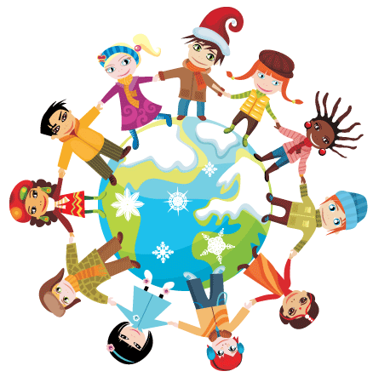
Christmas TIME...
Around The World

Slide 2
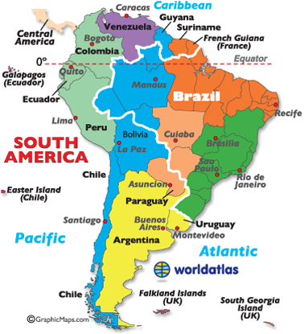
South America

Slide 3
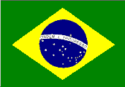
Brazil
Merry Christmas
Feliz Natal

Slide 4
Christmas time….there is very hot in Brazil because it comes at the beginning of their summer.
Father Christmas wears red silk because it is too hot for him to wear the same clothes as he does in the UK.
In Brazil they call Father Christmas ‘Papai Noel’

Slide 5
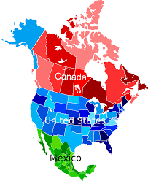
North America

Slide 6
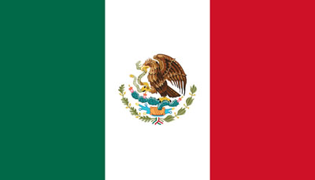
Mexico
Merry Christmas
Feliz Nochebuena

Slide 7
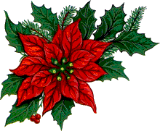
Do you know what Nochebuena is?
The Mexican name of the flower (in England) poinsettia, was discovered in Taxco and the valleys surrounding Cuernavaca.
It is symbol of abundance and good luck.

Slide 8
United States
Merry Christmas

Slide 9
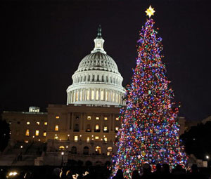
Every year the White House is decorated with Christmas lights and a huge Christmas tree is placed outside. This tradition started in 1923 with President Calvin Coolidge (30-th President).

Slide 10
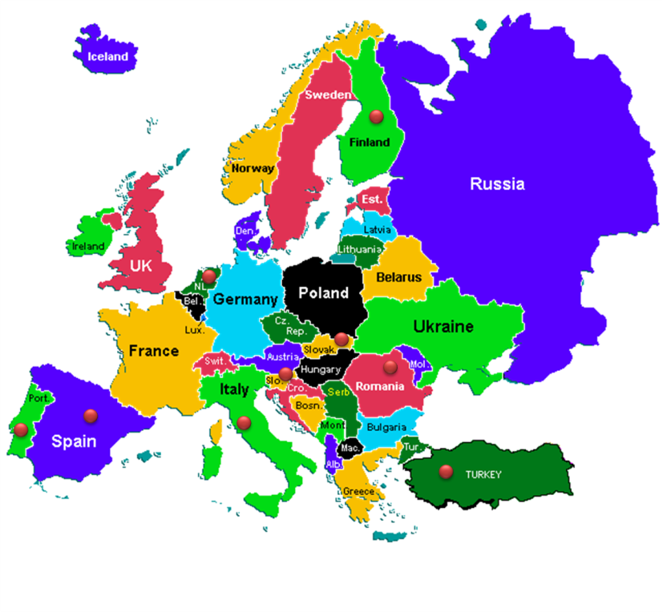
Europe

Slide 11
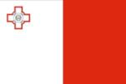
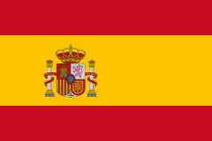
SPAIN
Feliz Navidad

Slide 12
The Spanish don’t share X-mas wafer as the Polish do. They eat „Turrón” which is mixture of nougat, almonds, honey, other nuts and egg white.
Do you know that in Spain there isn’t Santa Claus who brings presents, but the Magi (Tres Reyes in Spanish).

Slide 13
ITALY
Buon Natale

Slide 14
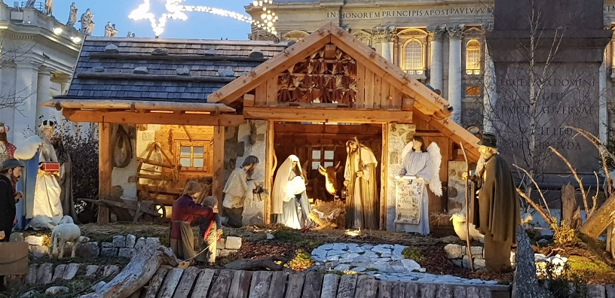
The most important symbol of Christmas in Italy is the nativity. In the nativity, you can find Joseph, with Mary next to him, holding Jesus in her arms.

Slide 15
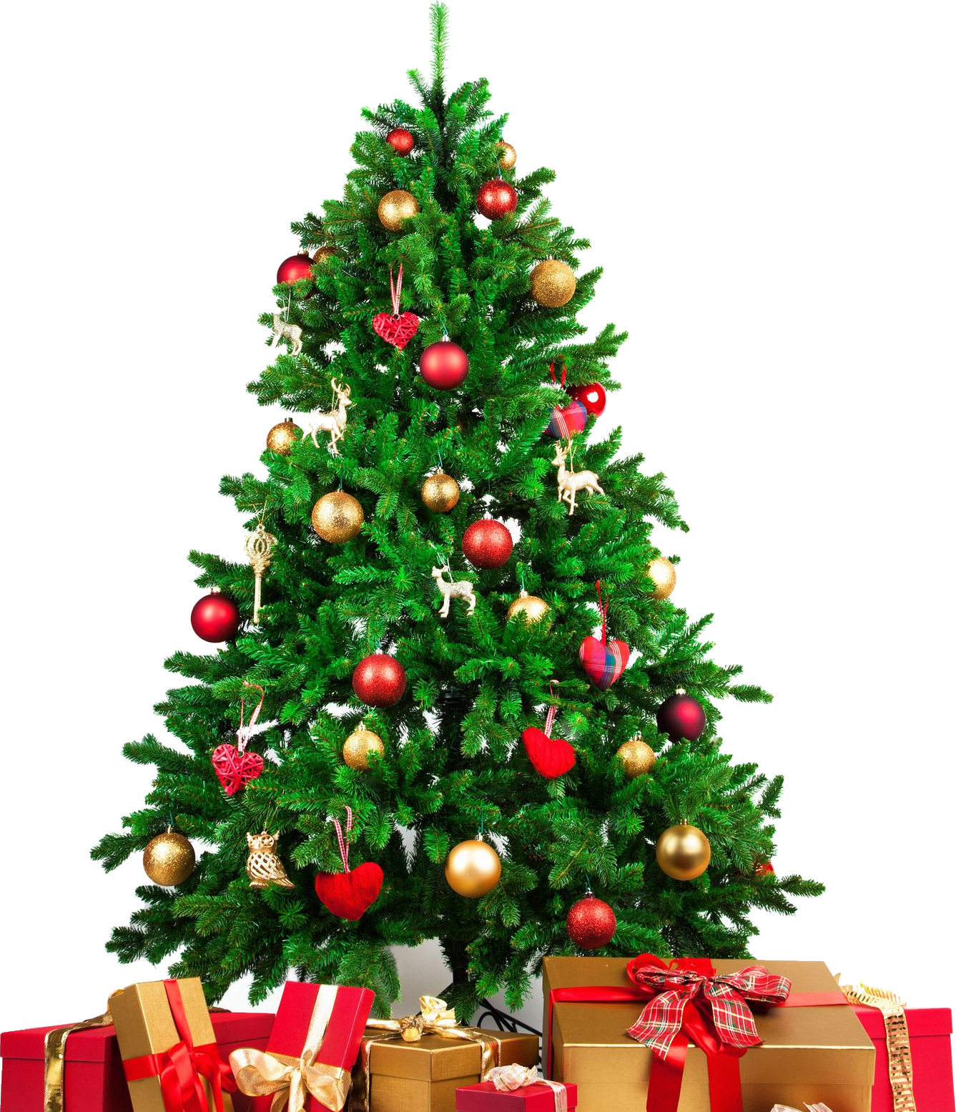
In Italy on 24th of December
Santa Claus arrives as in many
countries and leaves the presents under the tree.

Slide 16
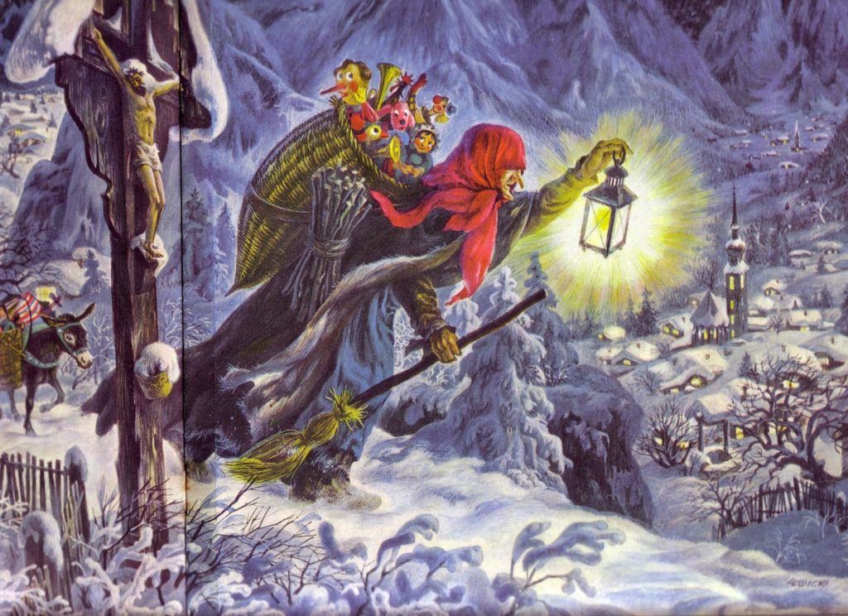
6th of January in Italy is the
,,BEFANA’S DAY’’. It
is a traditional festival for children.
A witch, travelling on a flying broom, leaves gifts in a sock for good children and coal for bad ones.

Slide 17
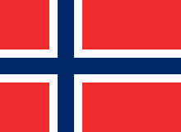
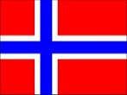
Norway
God Jul

Slide 18
It is tradition in Norway to ‘circle the tree’ before opening presents. Families stand in a big circle around the Christmas tree, hold hands and walk or dance around the tree singing Christmas carols.

Slide 19
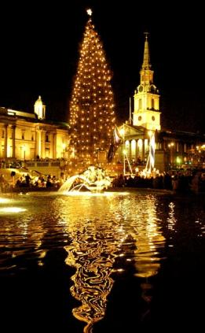
CHRISTMAS TREE –
in the heart of Trafalgar Square.
It’s a gift from Norway.
Every year the people of Oslo, Norway give London a huge Christmas tree (over 20 metres tall).

Slide 20
England
Merry Christmas

Slide 21
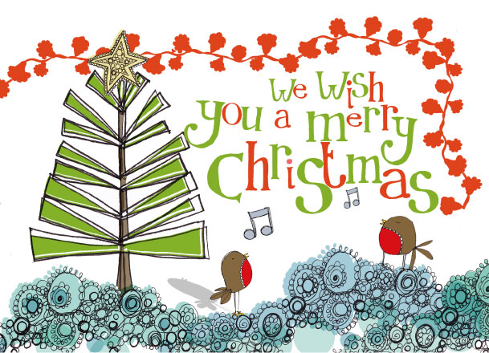
Boxing Day is a holiday celebrated the day after Christmas Day.
It originated in the United Kingdom and is celebrated in many countries.

Slide 22
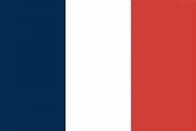
France
Joyeux Nöel

Slide 23
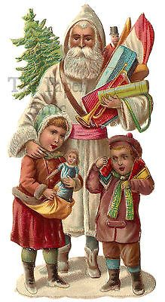
In France, Santa is called Père Noël (Father Christmas). In eastern France he is accompanied by Le Pere Fouettard, a man dressed in black.

Slide 24
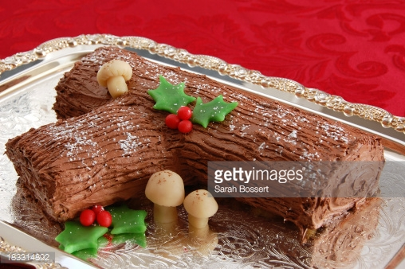
The main Christmas meal, called Réveillon, people eat on Christmas Eve/early Christmas morning. Dishes include roast turkey with chestnuts or roast goose, oysters, lobster, venison and cheese. For dessert, a chocolate sponge cake log called a bûche de Noël .

Slide 25
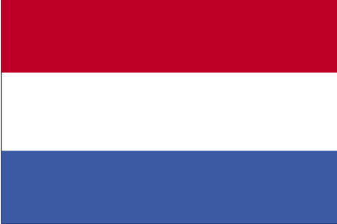
The netherlands
Vrolijk Kerstfeest

Slide 26
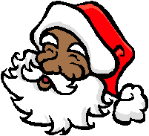
The main Christmas celebration in the Netherlands is on St. Nicholas’ feast day which is 6th of December.
Dutch people celebrate Sinterklaasavond ; it is our Christmas Eve.
Do you know? The name of Santa Claus comes from the Dutch word for St. Nicholas – Sinterklaas.

Slide 27
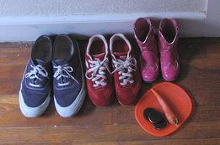
What do you think Dutch children leave instead of stockings for Sinterklaas to fill?
On Sinterklaasavond children leave out their shoes in the hope that Sinterklaas will fill them with presents. They also leave a carrot in their shoes for Sinterklaas’ horse.

Slide 28
Germany
Frohe
Weihnachten

Slide 29
German children also put their shoes out in hope that they will be filled with presents, just like Dutch children.
Good children get presents. Their shoes are filled with sweets and chocolates.
Naughty children receive rots from St. Nicholas’ companion Knecht Ruprecht (Krampus)

Slide 30
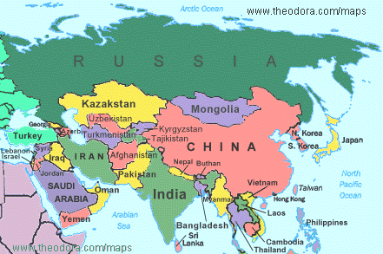
Asia

Slide 31
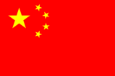
China
Merry Christmas
Shang Dan Jiang

Slide 32
How do Christians in China decorate their houses for Christmas?
They use bright coloured paper lanterns to decorate for Christmas. They put candles inside and the light shines brightly through the coloured paper.

Slide 33
Who do you think Sheng Dan Lao Ren is?
Christmas Day is not a public holiday in China like in England. People go to work and children go to school. This is because China is mainly a Buddhist country. Their biggest celebration is Chinese New Year which usually falls in January or February.
Chinese children hang up stockings in the hope that Sheng Dan Lao Ren will visit them and fill them with presents.

Slide 34
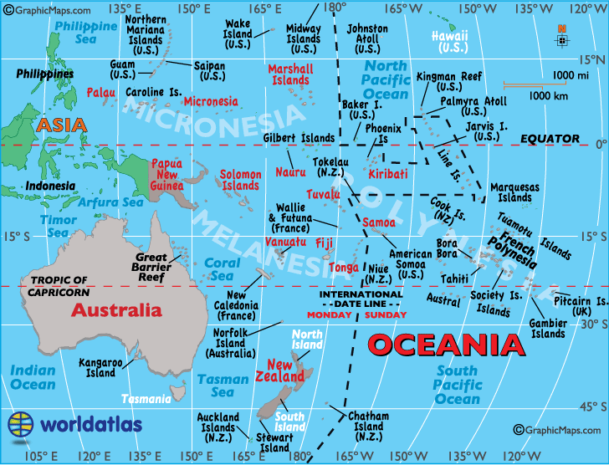
Oceania

Slide 35
Australia
Merry Christmas

Slide 36
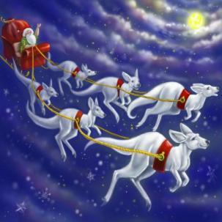
Santa’s sleigh is pulled by six white kangaroos!
What pulls Santa’s sleigh around Australia instead of Reindeer?
CLUE: Australians sometimes call these animals “Boomers”…

Slide 37
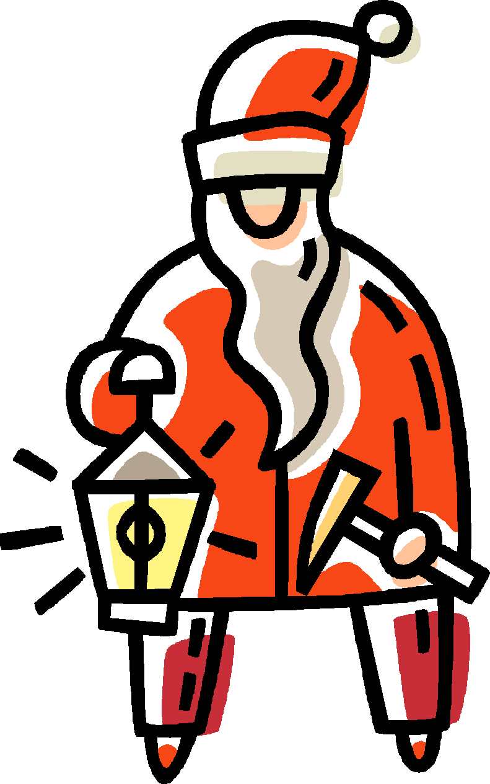
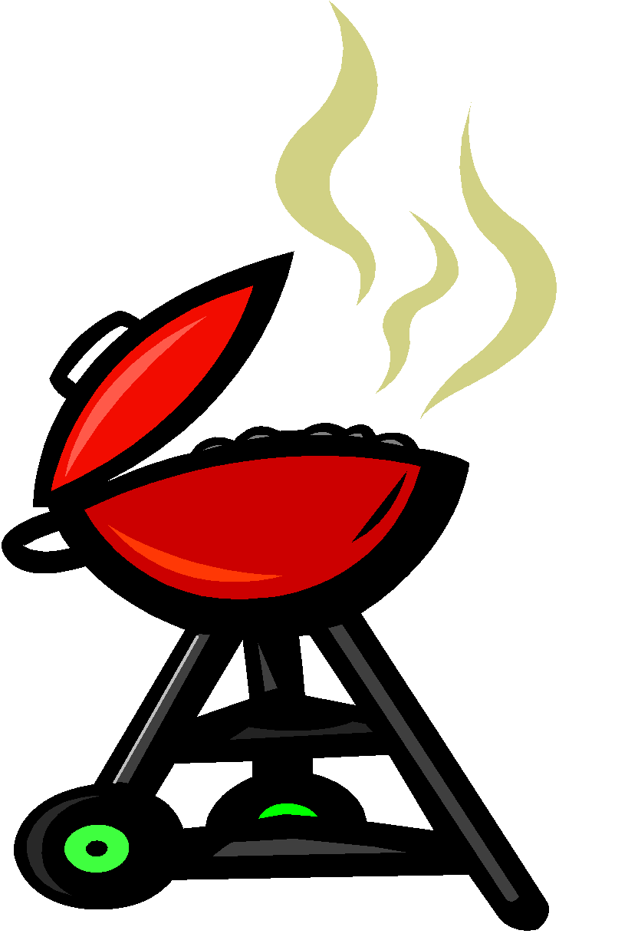
It is summer in Australia at Christmas so it is very, very hot. Families often go to the beach on Christmas Day and instead of having a hot roast turkey dinner they have a barbeque ☺

Slide 38
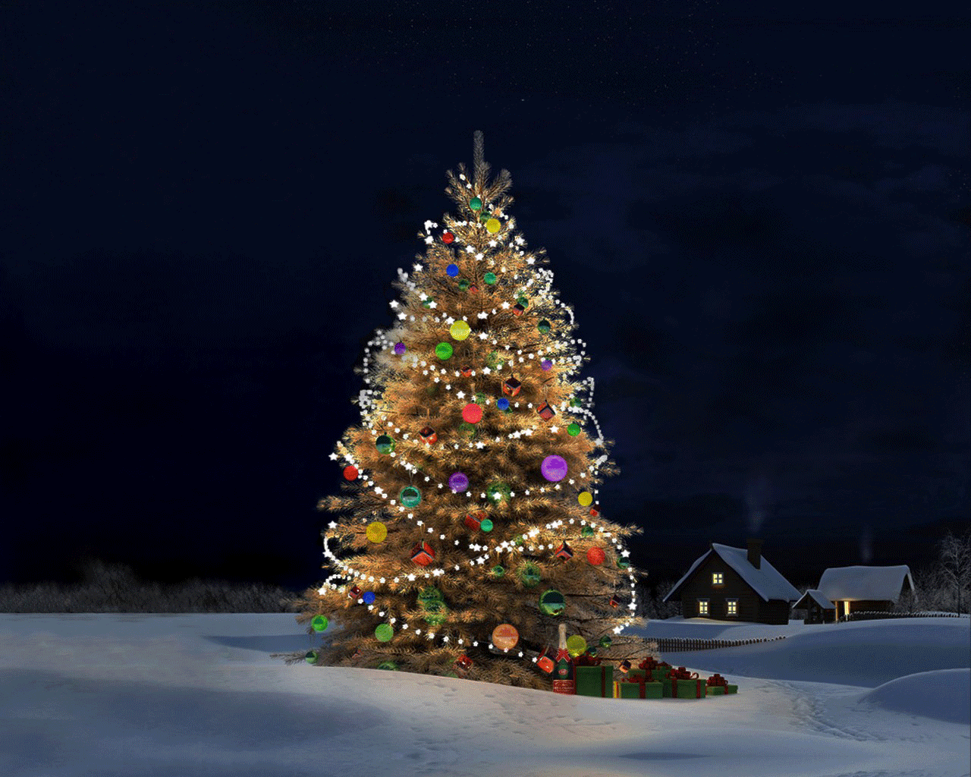
We wish you a Merry Christmas and a happy
New Year!
🎄
🎄

